Slide 1


Independent study: Image and Audio Generation and Editing using Python
Phileas Dazeley Gaist, College of the Atlantic, Fall term 2021

Slide 2
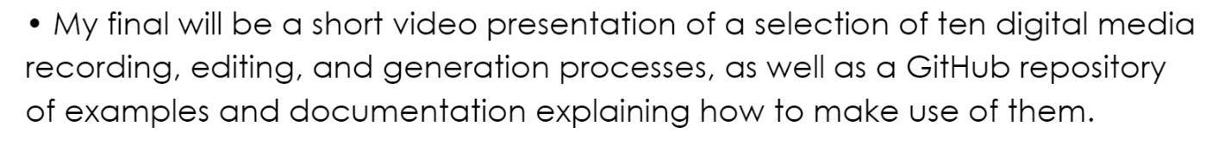

Slide 3

Media files == arrays of data
Image files = 2d or 3d arrays of shape (height, width, channels)
Audio files = n-dimensional arrays of shape of shape (channel1, channel2…) + a sample rate
Video files ≈ a list of arrays of images + an audio array

Slide 4

N-dimensional arrays = n-dimensional arrays subdivided N-n times
Where N represents a number of dimensions superior to n.
A 1d array can be turned into a 2d array by splitting the dimension of the array into a number of smaller arrays (one division).
A 2d array can be turned into a 3d array by dividing the “deepest” axis of the array into a number of smaller arrays (one division)
To go from a 1d array to a 3d array requires a 2 division of the axis of the 1d array. This principle is generalisable to any number of dimensions.

Slide 5

What this means: the number of dimensions doesn’t really matter
For our purposes, we can edit audio or image arrays using the same tools.
*This does not extent to video because videos are more analogous to lists: they contain arrays of different types and different sizes, which contrary to variances in the number of dimensions, makes our life a little harder.
Notes:
- 10 weeks to publish repo with media shenanigans python package
- decided to approach editing images and audio using the same tools
- viewing audio channels in an audio file as very short very wide images, or very tall very narrow images (1px by n)

Slide 6
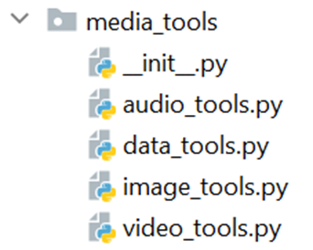

The `media_tools` package
Data can be
Mapped
Transformed
Generated
Messed with (transformations, but wacky)
Notes:
To facilitate the task of working with image, audio, and video data in python, I have compiled a list of convenience functions into a package called `media_tools`, which allows for a number of media manipulation and generation approaches.
Video tools allows you to read, edit, and save videos, but because the video stuff is a lot more complicated, my code isn’t as thorough, and this presentation is already quite long, I’ve opted to leave it out of the discussion for today.

Slide 7

Examples:
Mapping, Transforming, and Generating data to be saved as media.

Slide 8

Mapping
Taking data from a media file of a certain type, casting it into the shape of a media file of another type, and reading it as another media file type.

Slide 9
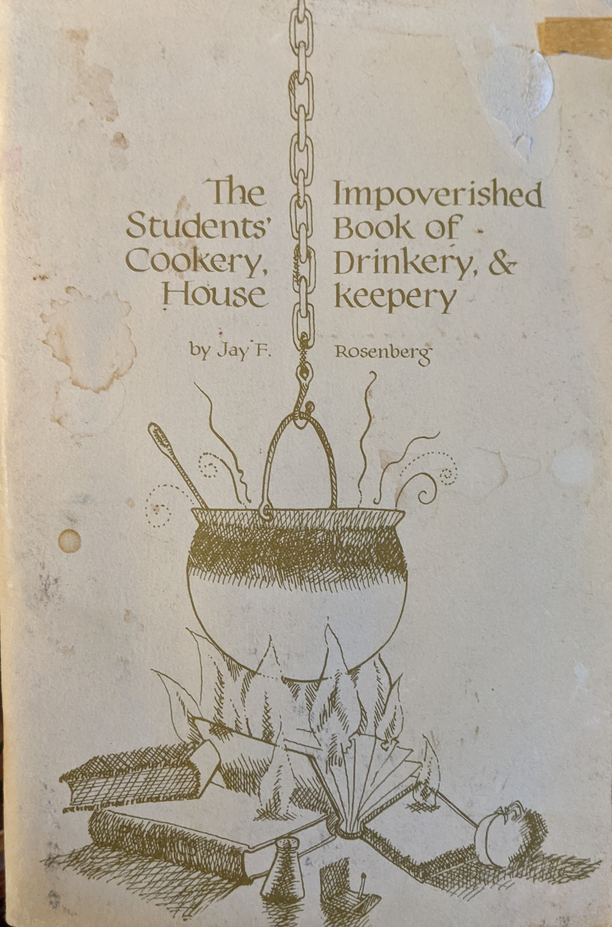
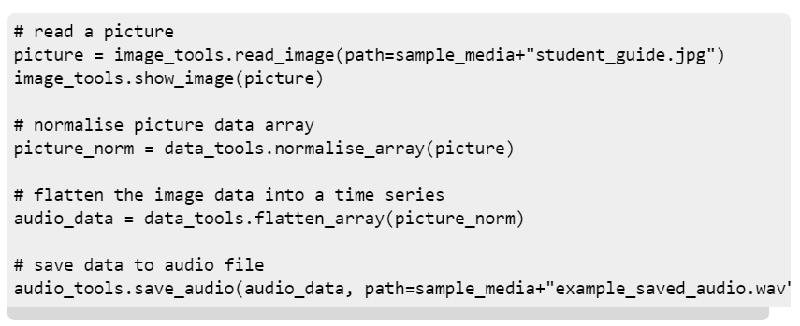
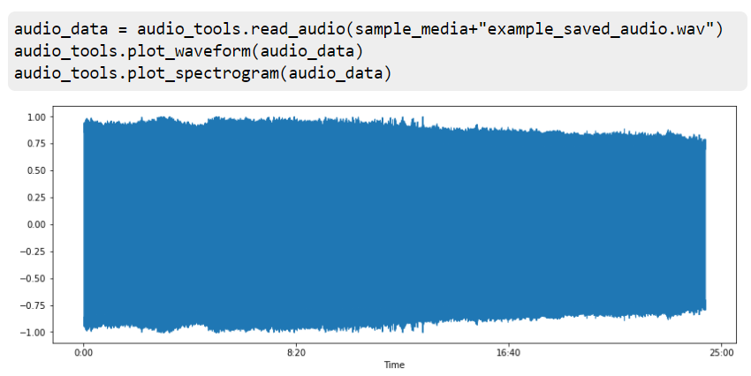

Slide 10
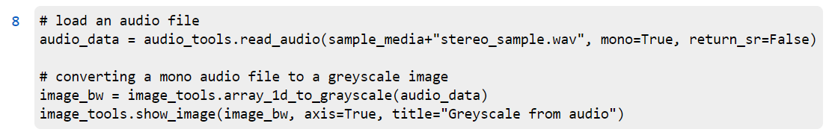
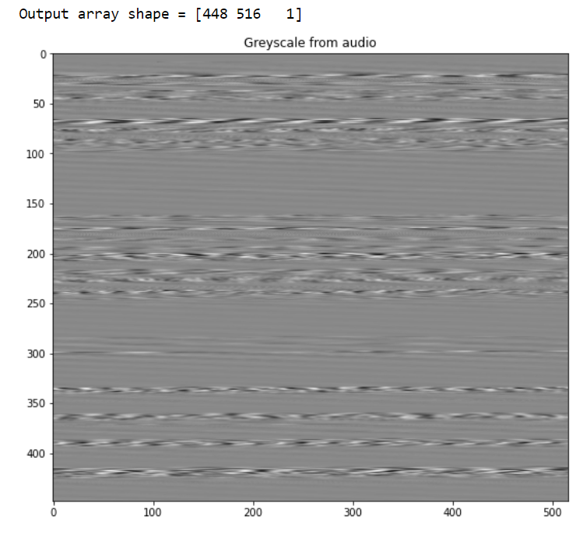

Slide 11
Transformations
Scaling
Rotation
Translation
Reflection
Cropping
Blitting

Slide 12
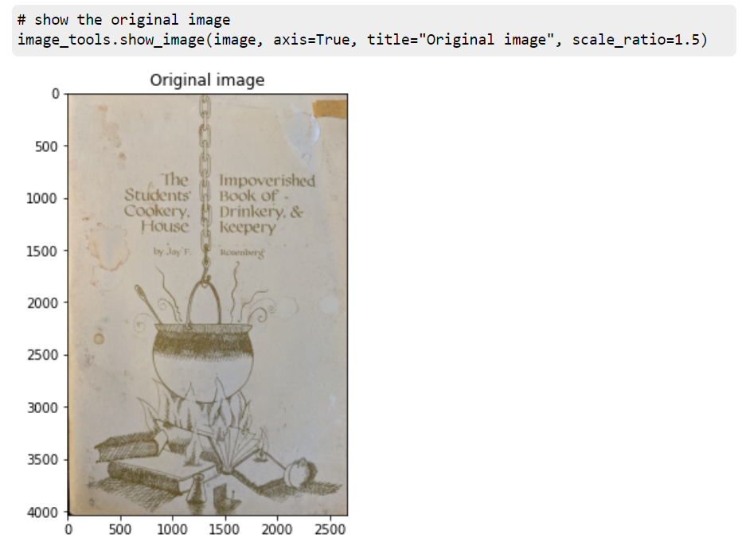
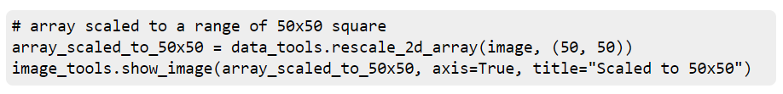
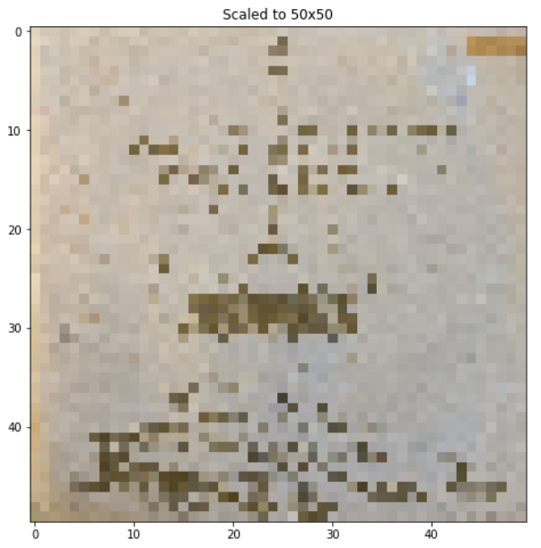

Slide 13
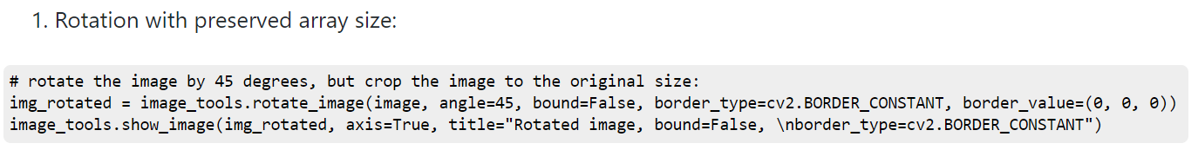
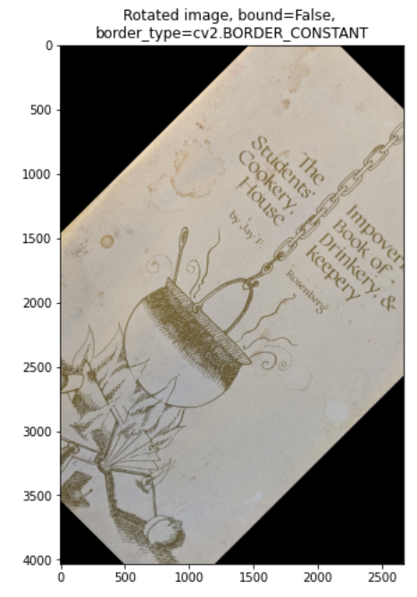

Slide 14
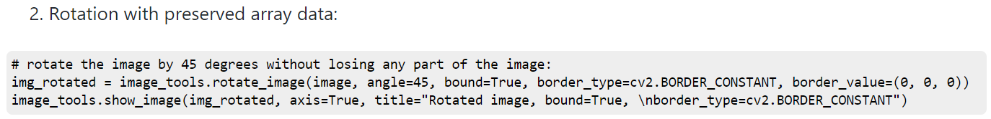
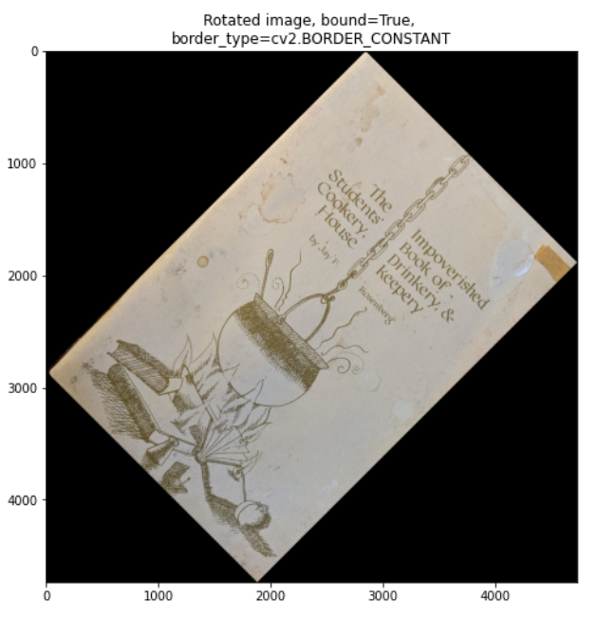

Slide 15
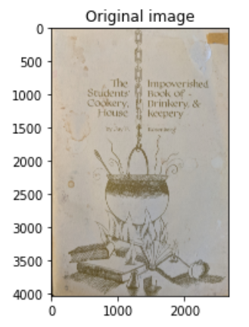
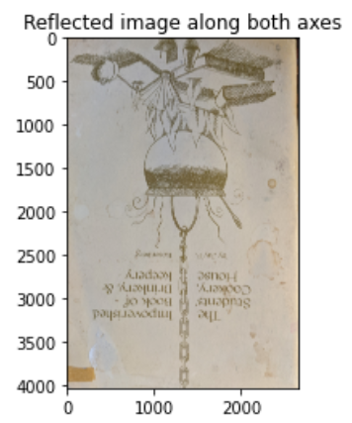
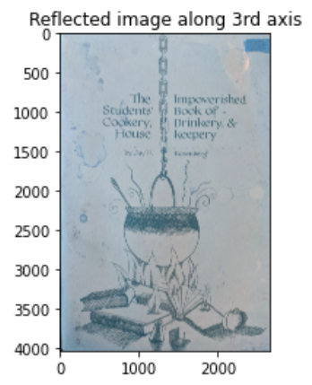

Slide 16
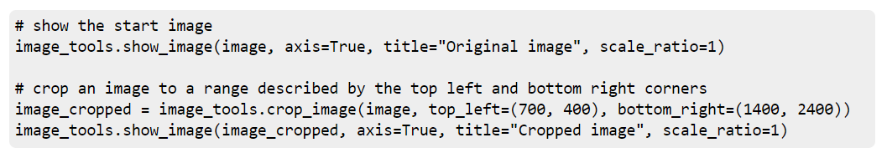
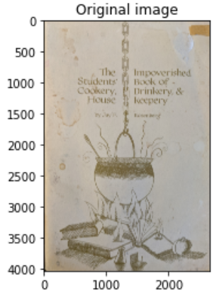
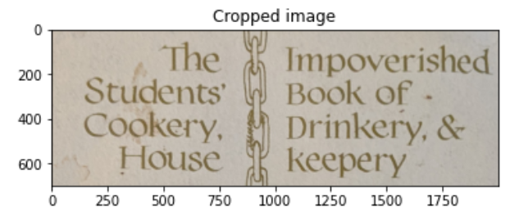

Slide 17
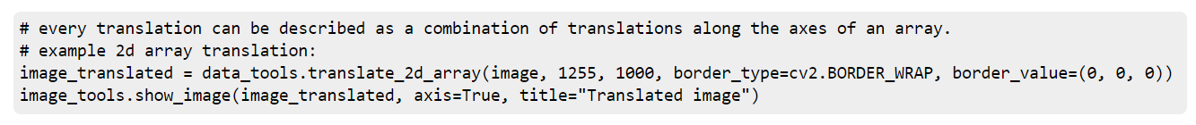
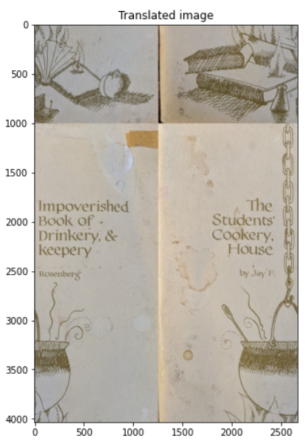

Slide 18
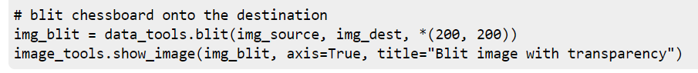
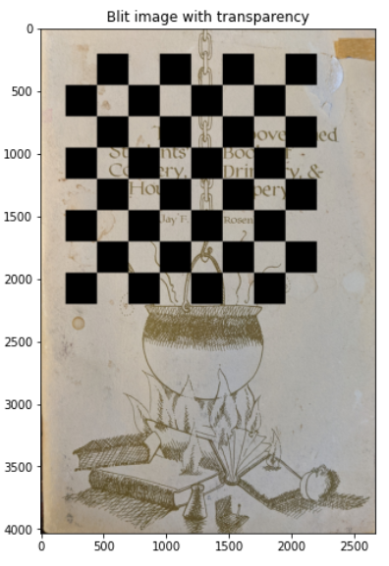


Slide 19
Generation
A couple of my favourite data generation tools (available in Data_generation.ipynb in the project documentation)
Chessboards
Stripes
Gradients

Slide 20
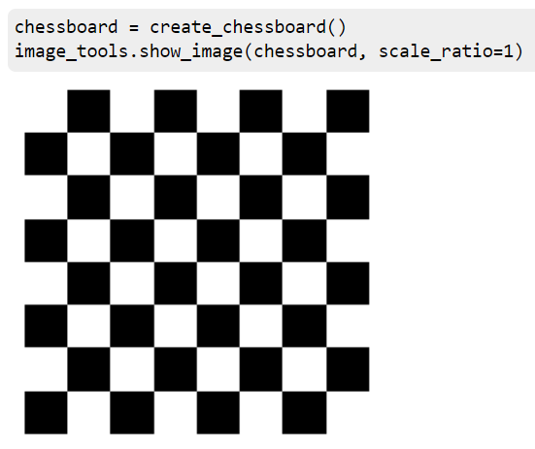
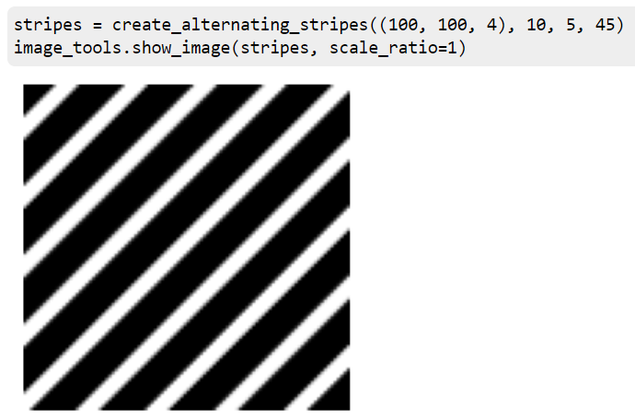

Slide 21
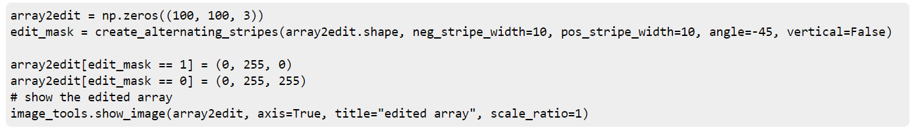
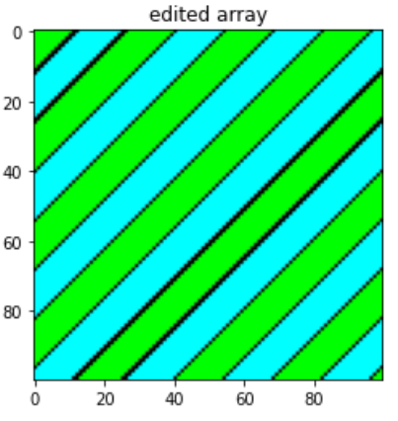

Slide 22

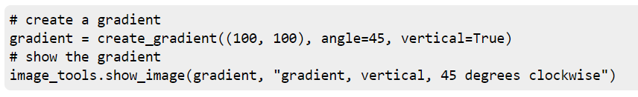

Slide 23
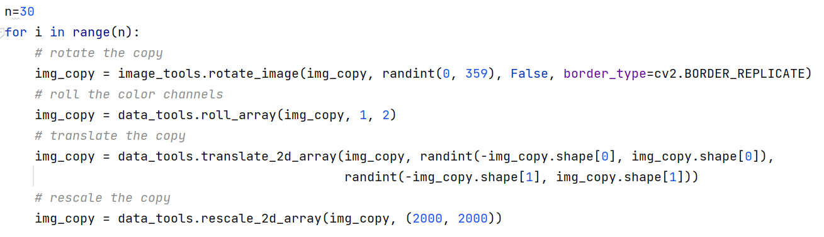

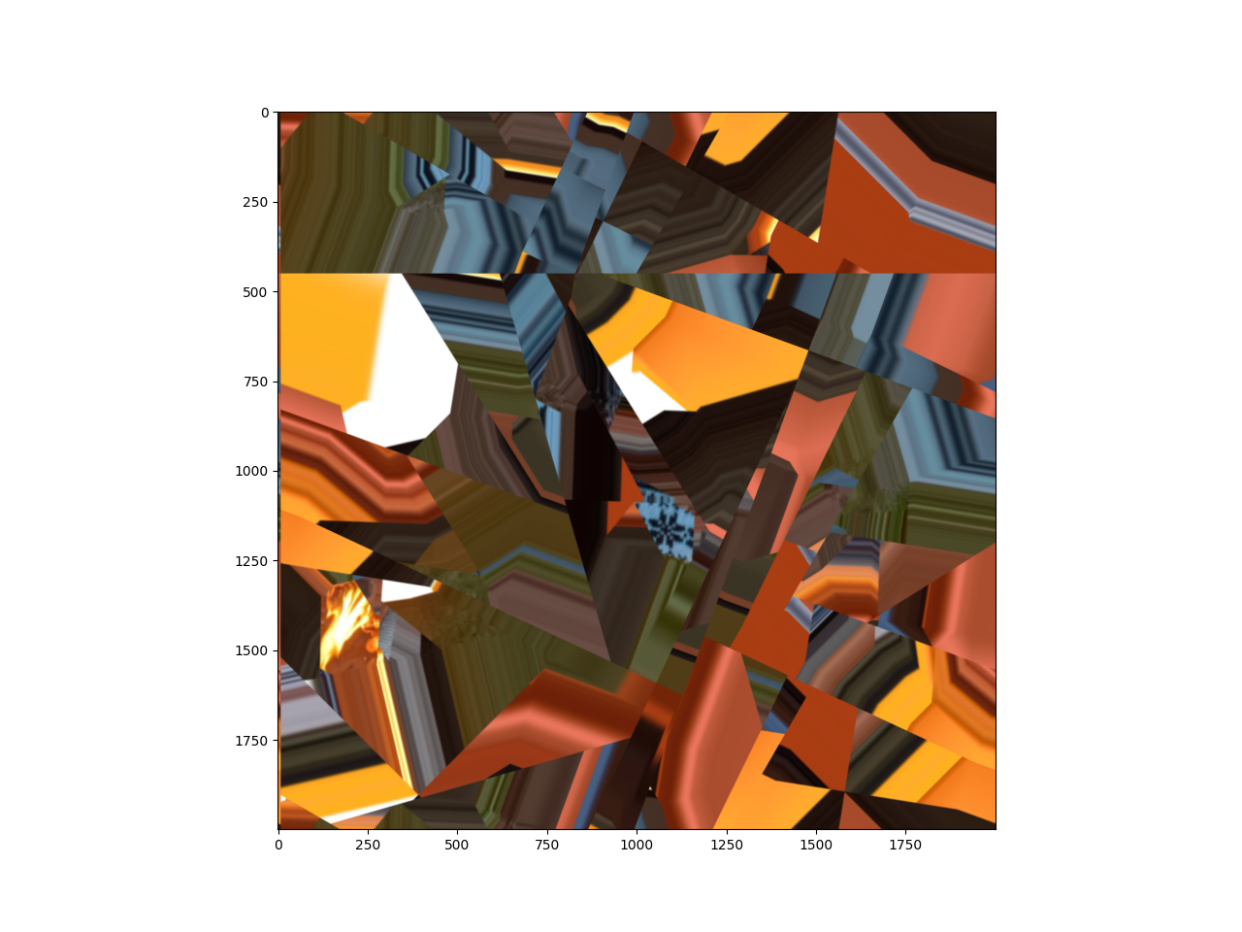

Slide 24
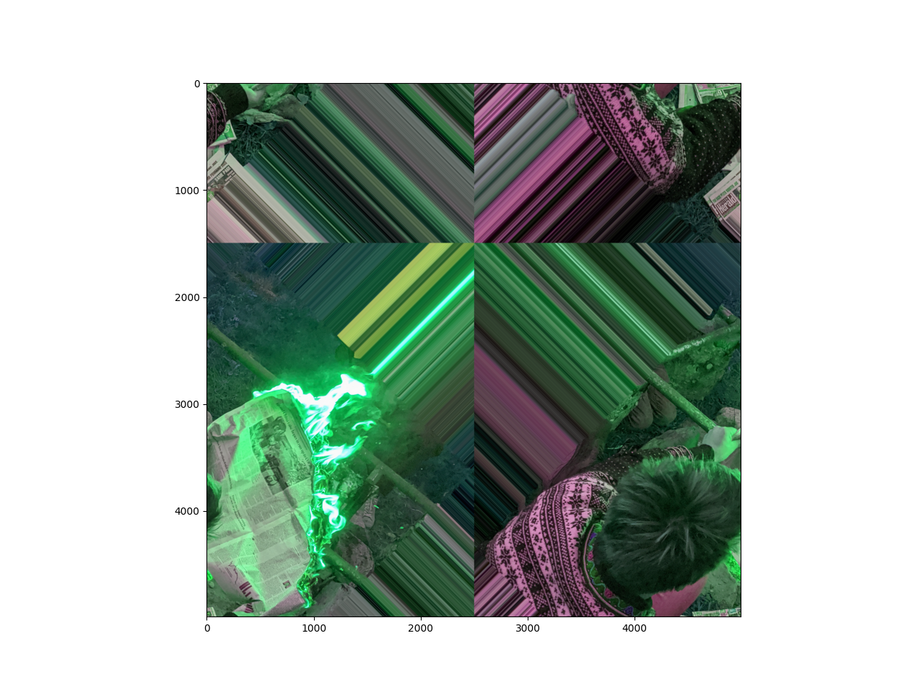
Notes:
N=1

Slide 25
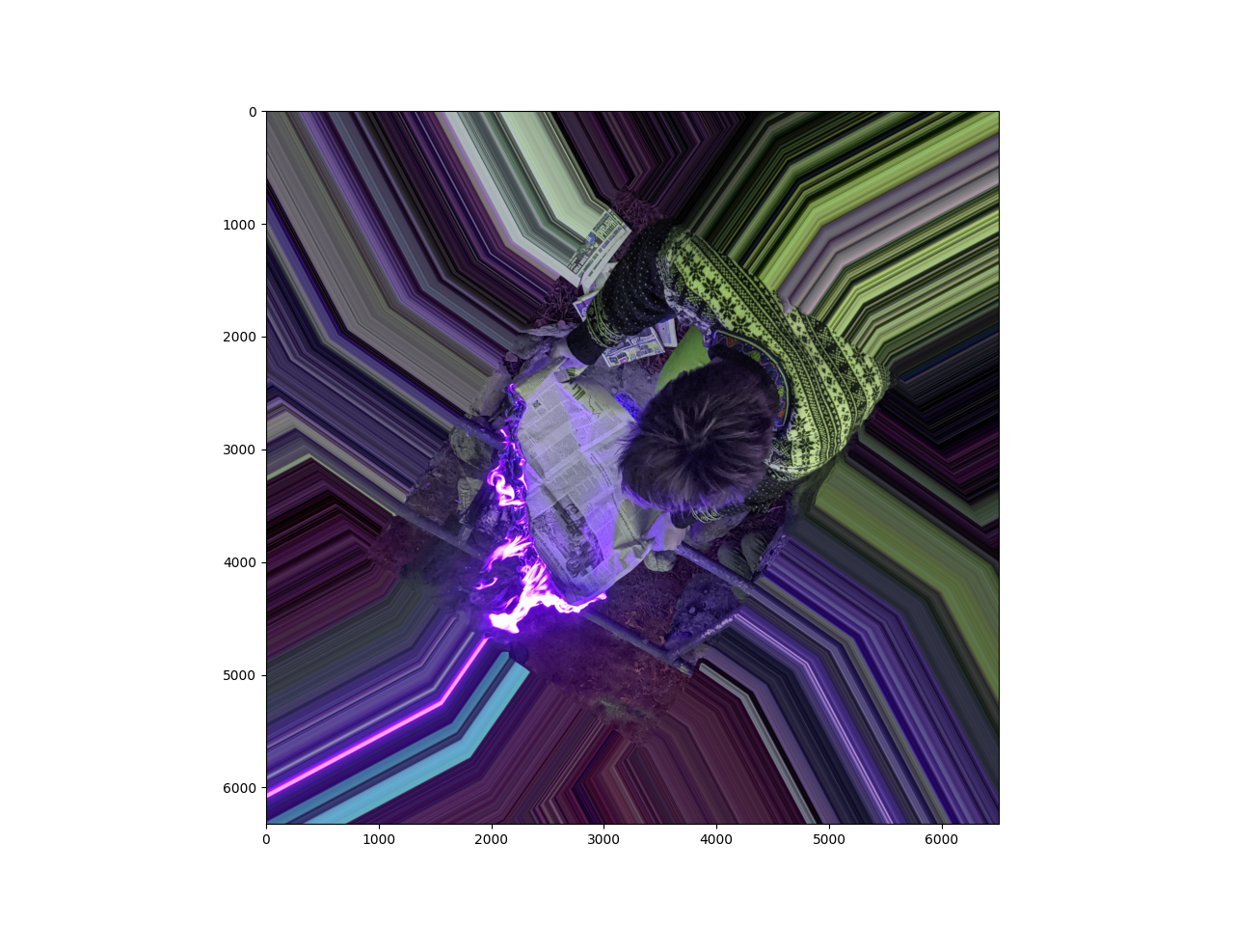
Notes:
N=2

Slide 26
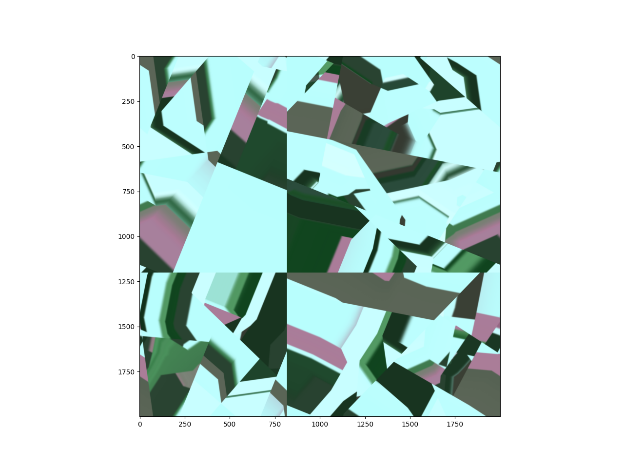
Notes:
N=100

Slide 27
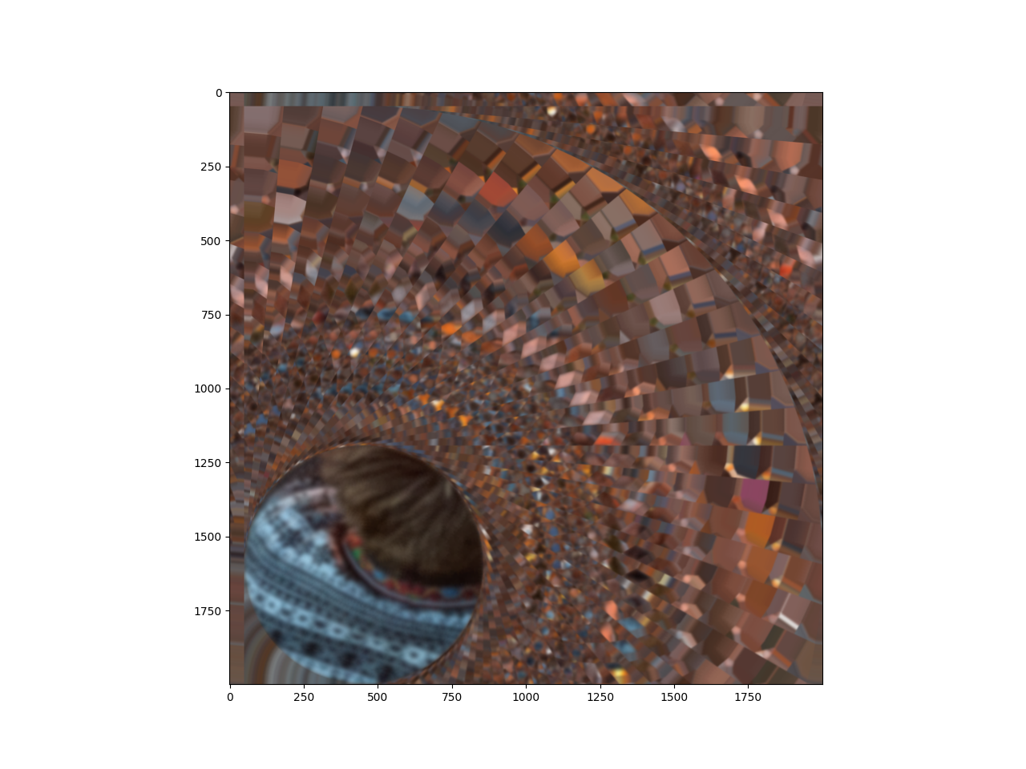
Notes:
n=360, rotation =5, translate_x = 50 translate_y =50

Slide 28
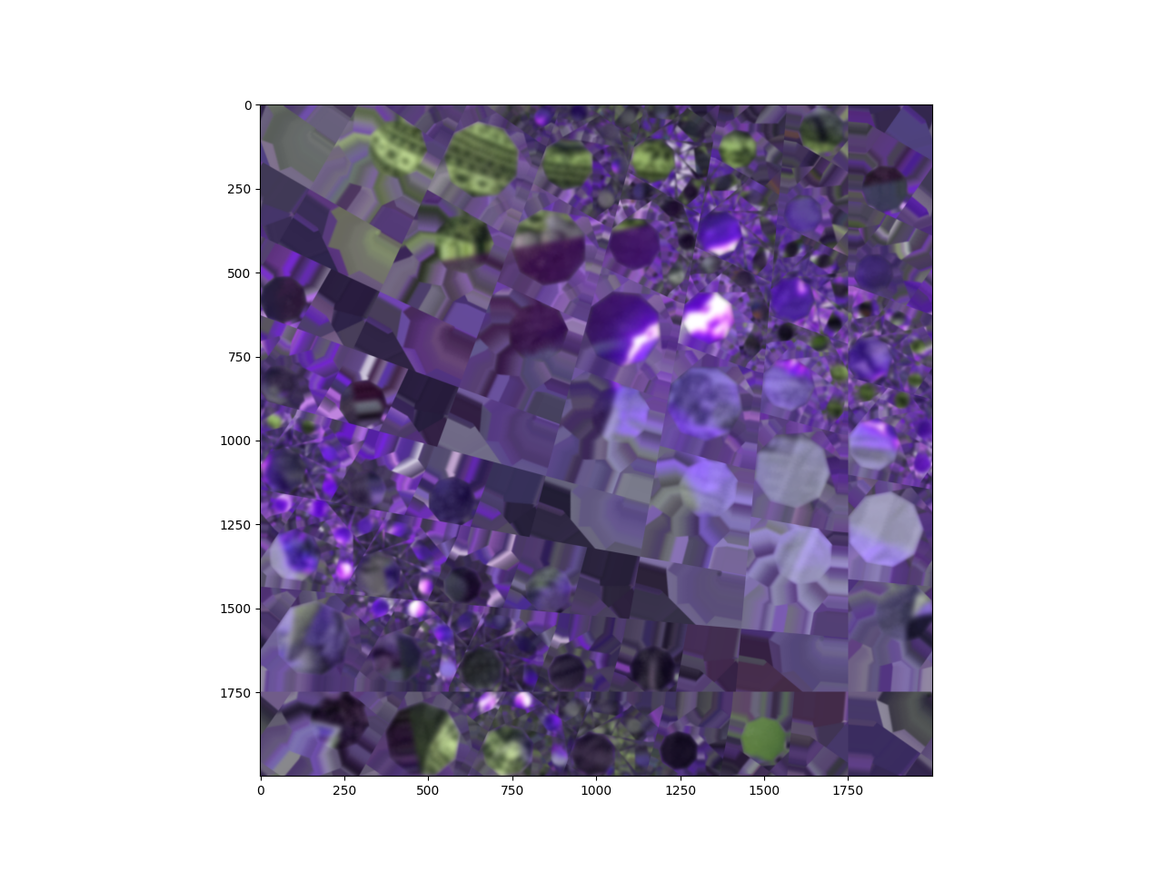
Notes:
n=360, rotation =5, translate_x = +or-250 translate_y = +or-250

Slide 29
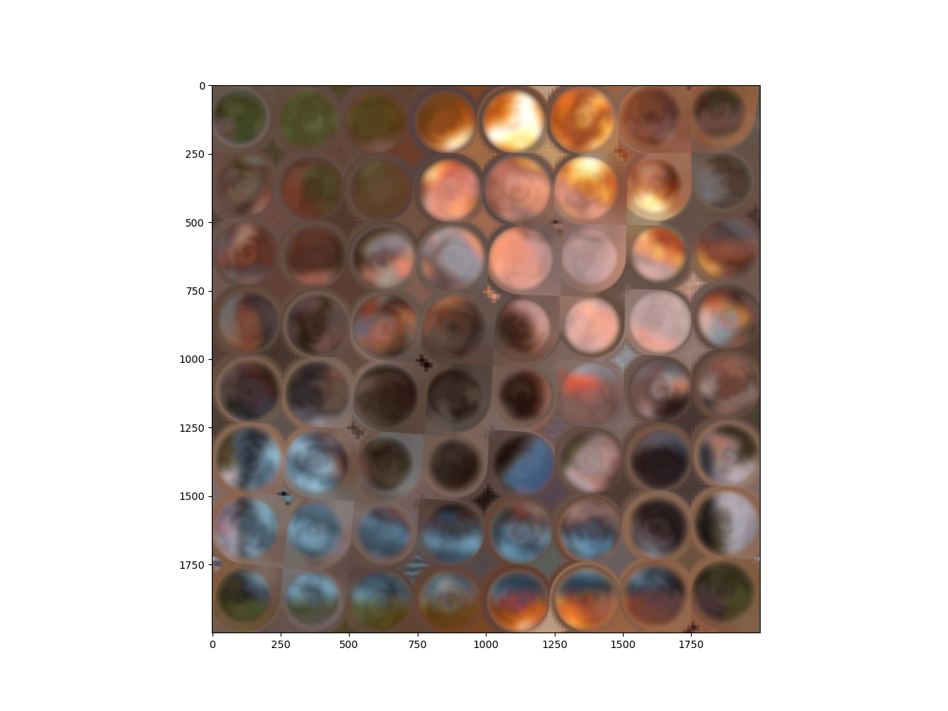
Notes:
N=360*5
rotation = choice([-1, 1, -5, 5])
translates = choice[-250, 250, -500, 500]

Slide 30
How to use this project yourself
Download Python
Head to https://github.com/phileasdg/Image_and_Audio_Generation_and_Editing_using_Python and download my code
Install the dependencies using the command: pip install -r requirements.txt
Mess around and have fun!

Slide 31
Bibliography of project sources
“Animated Image Using a Precomputed List of Images — Matplotlib 3.4.3 Documentation.” Accessed September 30, 2021. https://matplotlib.org/stable/gallery/animation/dynamic_image.html.
“Animation Example Code: Dynamic_image.Py — Matplotlib 2.0.2 Documentation.” Accessed September 30, 2021. https://matplotlib.org/2.0.2/examples/animation/dynamic_image.html.
Cross Validated. “Data Transformation - What Does ‘Normalization’ Mean and How to Verify That a Sample or a Distribution Is Normalized?” Accessed September 27, 2021. https://stats.stackexchange.com/questions/70553/what-does-normalization-mean-and-how-to-verify-that-a-sample-or-a-distribution.
GeeksforGeeks. “Different Ways to Create Pandas Dataframe,” November 14, 2018. https://www.geeksforgeeks.org/different-ways-to-create-pandas-dataframe/.
“How to Use Loc and Iloc for Selecting Data in Pandas | by B. Chen | Towards Data Science.” Accessed September 26, 2021. https://towardsdatascience.com/how-to-use-loc-and-iloc-for-selecting-data-in-pandas-bd09cb4c3d79.
Stack Overflow. “Image - Matplotlib Imshow(): How to Animate?” Accessed September 30, 2021. https://stackoverflow.com/questions/17212722/matplotlib-imshow-how-to-animate.
“Librosa — Librosa 0.8.1 Documentation.” Accessed September 26, 2021. https://librosa.org/doc/main/index.html.

Slide 32
Bibliography of project sources (cont’d)
Cross Validated. “Normalization - How to Normalize Data to 0-1 Range?” Accessed September 27, 2021. https://stats.stackexchange.com/questions/70801/how-to-normalize-data-to-0-1-range.
“NumPy Array Slicing.” Accessed September 26, 2021. https://www.w3schools.com/python/numpy/numpy_array_slicing.asp.
“Numpy.Clip — NumPy v1.21 Manual.” Accessed September 27, 2021. https://numpy.org/doc/stable/reference/generated/numpy.clip.html.
“OpenCV: Color Space Conversions.” Accessed September 26, 2021. https://docs.opencv.org/3.4.15/d8/d01/group__imgproc__color__conversions.html.
“OpenCV: OpenCV-Python Tutorials.” Accessed November 18, 2021. https://docs.opencv.org/4.x/d6/d00/tutorial_py_root.html.
“Pyplot vs Object Oriented Interface · Matplotblog.” Accessed September 26, 2021. https://matplotlib.org/matplotblog/posts/pyplot-vs-object-oriented-interface/.
Stack Overflow. “Python - How to Load All Modules in a Folder?” Accessed September 26, 2021. https://stackoverflow.com/questions/1057431/how-to-load-all-modules-in-a-folder.
Stack Overflow. “Python - How to Normalize a NumPy Array to within a Certain Range?” Accessed September 27, 2021. https://stackoverflow.com/questions/1735025/how-to-normalize-a-numpy-array-to-within-a-certain-range.

Slide 33
Bibliography of project sources (cont’d)
Stack Overflow. “Python - Specifying and Saving a Figure with Exact Size in Pixels.” Accessed September 27, 2021. https://stackoverflow.com/questions/13714454/specifying-and-saving-a-figure-with-exact-size-in-pixels.
Stack Overflow. “Python - Understanding Slice Notation.” Accessed September 26, 2021. https://stackoverflow.com/questions/509211/understanding-slice-notation.
Stack Overflow. “Python - Using OpenCV to Overlay Transparent Image onto Another Image.” Accessed November 18, 2021. https://stackoverflow.com/questions/40895785/using-opencv-to-overlay-transparent-image-onto-another-image.
Stack Overflow. “Python: Want to Display Red Channel Only in Opencv.” Accessed September 27, 2021. https://stackoverflow.com/questions/44554125/python-want-to-display-red-channel-only-in-opencv.
Roberts, Leland. “Understanding the Mel Spectrogram.” Analytics Vidhya (blog), March 14, 2020. https://medium.com/analytics-vidhya/understanding-the-mel-spectrogram-fca2afa2ce53.
The Coding Train. Coding Challenge #47: Pixel Sorting in Processing, 2016. https://www.youtube.com/watch?v=JUDYkxU6J0o.
“The N-Dimensional Array (Ndarray) — NumPy v1.21 Manual.” Accessed September 27, 2021. https://numpy.org/doc/stable/reference/arrays.ndarray.html.

Slide 34
Bibliography of project sources (cont’d)
“Using Display.Specshow — Librosa 0.8.1 Documentation.” Accessed September 26, 2021. https://librosa.org/doc/main/auto_examples/plot_display.html#sphx-glr-auto-examples-plot-display-py.
Science ABC. “Why Is The Loudness Of Sound Expressed In Negative Decibels Sometimes?,” December 1, 2018. https://www.scienceabc.com/pure-sciences/why-negative-decibels-are-a-thing.html.
“Matplotlib.Animation.ArtistAnimation — Matplotlib 3.4.3 Documentation.” Accessed September 30, 2021. https://matplotlib.org/stable/api/_as_gen/matplotlib.animation.ArtistAnimation.html.
Stack Overflow. “Minimum Value on a 2d Array Python.” Accessed September 27, 2021. https://stackoverflow.com/questions/44431412/minimum-value-on-a-2d-array-python.

